Slide 1
XYZ Corp - Loan Probability Defaulter’s – Predictions
Data science Pro Degree – Project
Santhosh Kumar A
July-2020

Slide 2
Agenda
Project Objective
Business Problem Statement
Analytics Tools
Analytics Approach
Model Insights
Recommendations
Appendix

Slide 3
Project Objective
Overview
Underwriters work primarily in banks which handle loans and mortgages and are responsible for analysing the risks of a loan based on the data in the application. They also oversee other information in the loan application to ensure it is accurate, to approve the loan.
Objective
Primary objective to identify the probability of loan defaulters, we will identify by building best binary “Classification” machine learning method with best ‘Recall/Sensitivity & ROC curve Metrics” according to the business guidelines.

Slide 4
Business Problem Statement
For approving the loan to applicant, as a Underwriter have to follow the different process and collect documents for the applicant. After collecting the credit history data for the applicants, has to deeply analyse and proceed further.
Important Issues Faced by Underwriter-
Missing information – Signature, documents etc.,
Income Discrepancies - Some borrowers fraudulently attempt to pad income information in an effort to secure an approval
Credit Issues - A history of late payments, too many lines of credit, and high balances
Funding issues - Source of Funds and where they originated

Slide 5

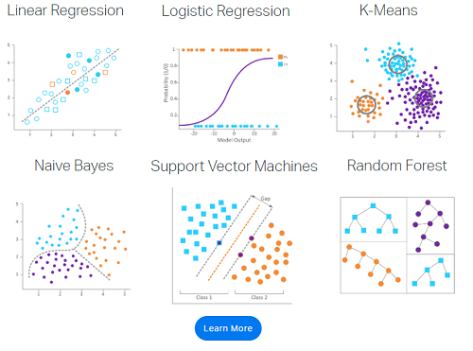

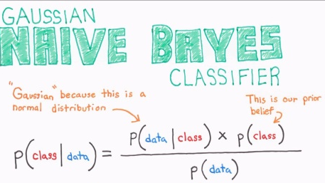
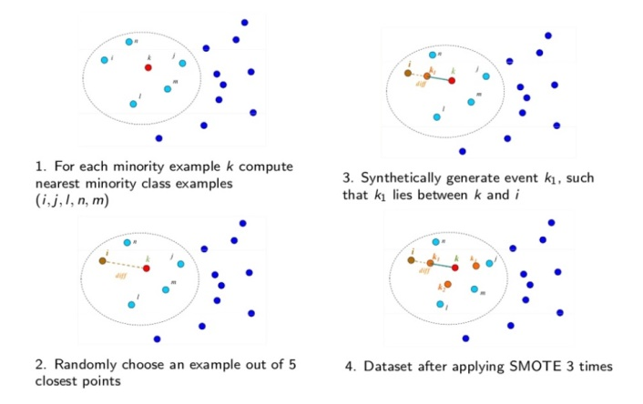
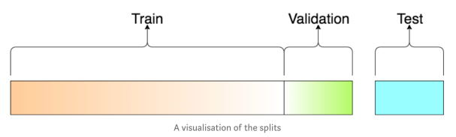
Analytics Tools

Slide 6
Analytics Approach contd.,
Data Loading
Statistical Summary
Information about Variable D-types
Exploratory Data Analysis
Missing Data Analysis
Splitting Target Variable
Feature Engineering
Dummy Variables encoding
Removing unwanted variables
EDA on Independent variables
Visualization
Viewing Shape of Data

Slide 7
Analytics Approach contd.,
Model Building
Running different classifier
GridSearchCV (Hypertuning Parameters)
Final Model Building
Validating Test Data with model
Train Data(For metrics Comparison)
Finalizing the better model with Recall Score
SMOTE (Sampling Minority)
Scaling the Data
Train data (train & test set splitting)
Train & Test (as per requirement)
Datasets Preparation

Slide 8
Model Insights

Slide 9
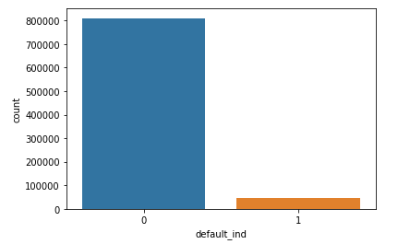
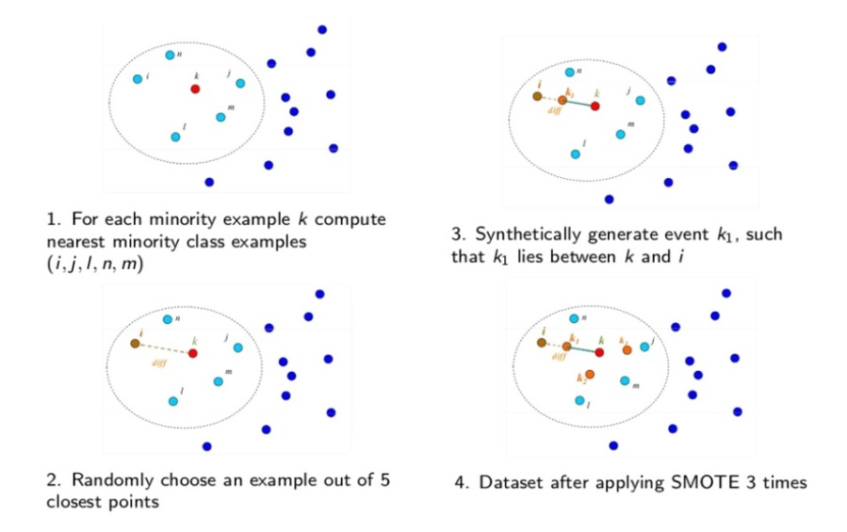
Exploratory Data Analysis – Target Variable
Target/Dependent Variable
Unique value counts
0 Class – 8,09,502 1 Class – 46,467 There is huge imbalance in dataset, will use SMOTE technique to balance the dataset.

Slide 10
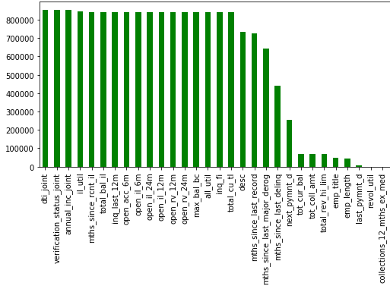
Exploratory Data Analysis – Missing Values
List of Missing values Columns
Missing values - Handled by
Removed variables having more than 7,00,000 missing values Variables less than that imputed by “Mean” values

Slide 11
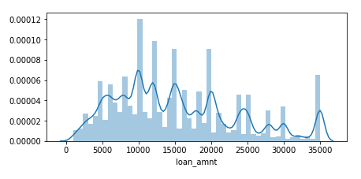
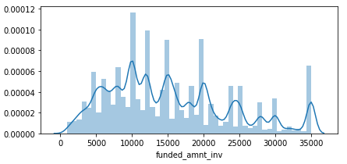
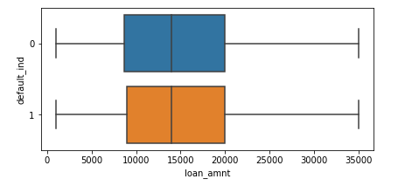
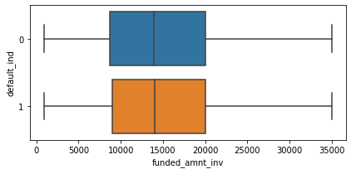
EDA - Loan_Amount , Funded _amnt _inv Vs Default_ind

Slide 12
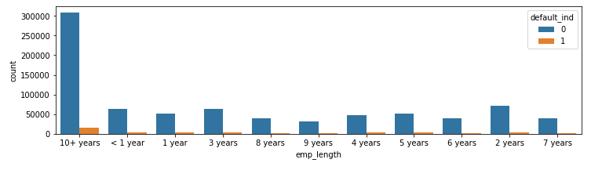
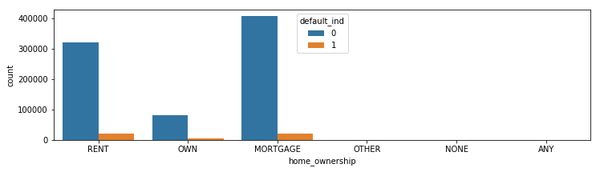
Distribution between Emp_length, Home_ownership Vs Default_ind

Slide 13
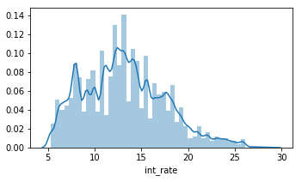
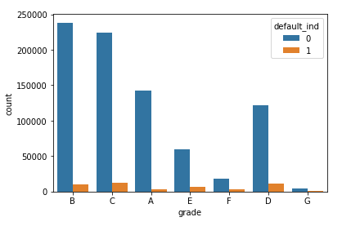
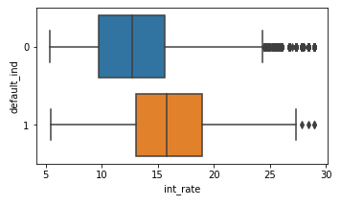
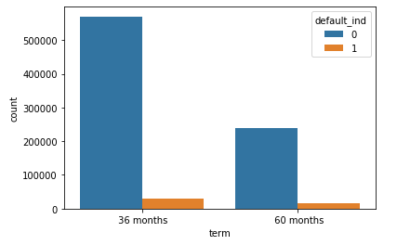
Distribution Interest Rate , Grade, Term Vs Default_ind

Slide 14
Correlation – Independent Variables
# | Variables | Correlation ()
1 | loan_amnt | -0.0049
2 | funded_amnt | -0.0058
3 | funded_amnt_inv | -0.0082
4 | int_rate | 0.1550
5 | installment | 0.0048
6 | annual_inc | -0.0371
7 | dti | 0.0044
8 | delinq_2yrs | -0.0092
9 | inq_last_6mths | 0.0744
10 | mths_since_last_delinq | 0.0013
11 | open_acc | -0.0217
12 | pub_rec | -0.0196
13 | revol_bal | -0.0207
14 | revol_util | 0.0445
15 | total_acc | -0.0211
# | Variables | Correlation ()
16 | out_prncp | -0.2260
17 | out_prncp_inv | -0.2260
18 | total_pymnt | -0.0392
19 | total_pymnt_inv | -0.0402
20 | total_rec_prncp | -0.0903
21 | total_rec_int | 0.0461
22 | total_rec_late_fee | 0.1408
23 | recoveries | 0.4757
24 | collection_recovery_fee | 0.3308
25 | last_pymnt_amnt | -0.0872
26 | collections_12_mths_ex_med | -0.0107
27 | mths_since_last_major_derog | -0.0137
28 | acc_now_delinq | -0.0031
29 | tot_coll_amt | -0.0019
30 | tot_cur_bal | -0.0363
31 | total_rev_hi_lim | -0.0336

Slide 15
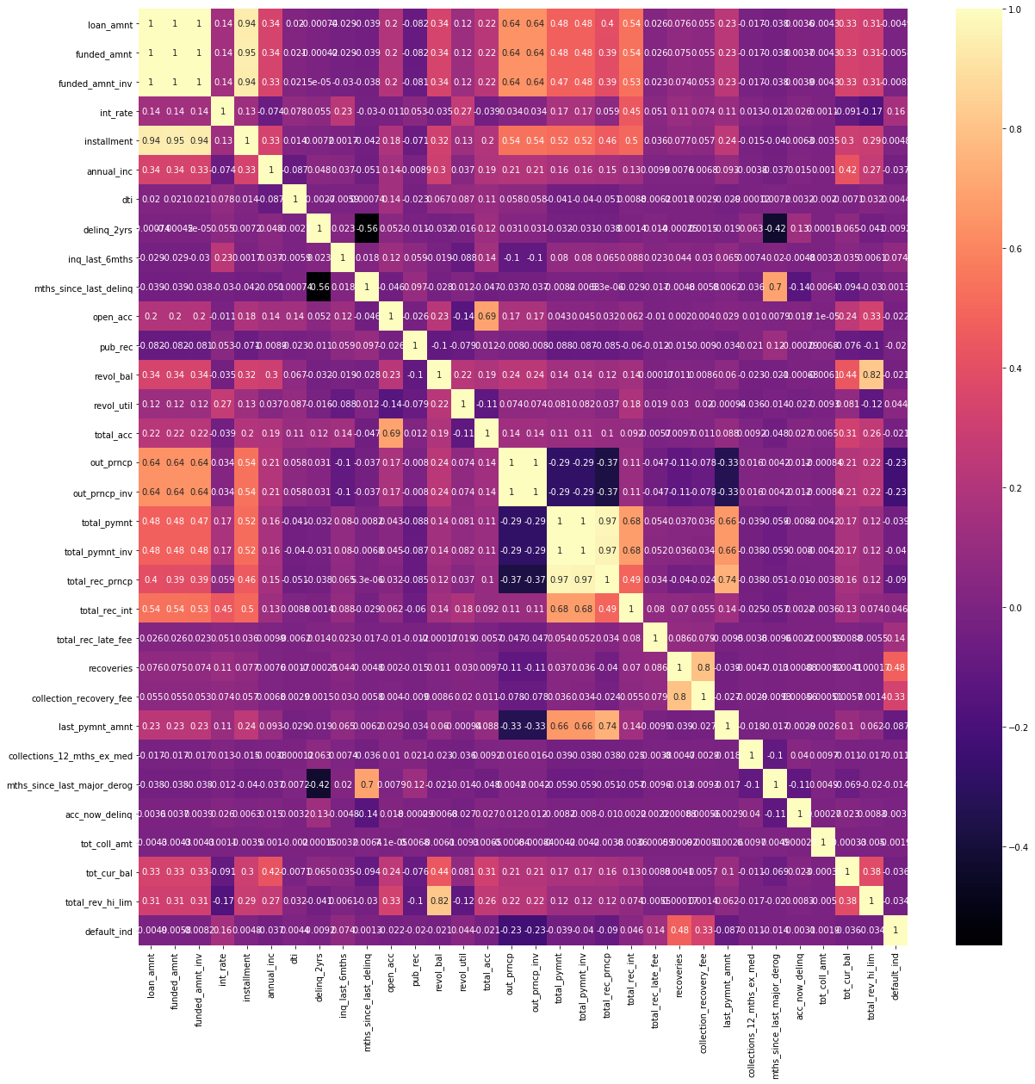
Correlation Plot between Variables

Slide 16
Feature Engineering – Creating Dummy Variables
List of Variables
Term - # of payments on the loan Grade – Loan grade system assigned Emp_length – Applicant employment history Home_ownership – Residing status of the applicant Verification – Applicant Income source verified status Purpose – Reason for applying loan - Inq_last_6mths – Queries raised by the applicant in last 6 months for applying loan Initial_list _status – Status of the loan application Next_pymnt_d – Payment date for the current loan/mortgage if any Application – Individual or joint

Slide 17

Datasets Preparation for Model Building
Preparation
As per business guidelines train data consider till May’2015, from June’2015 till December’2015 for test data.
Scaling the Train Dataset
Dataset is skewed will used MinMaxScaler method to normalization the data. MinMaxScaler is to rescale variables into the range [0,1], scaler is defined, fit on the whole dataset and then used to create a transformed version of the dataset with each column normalized independently, that the largest raw value for each column now has the value 1.0 and the smallest value for each column now has the value 0.0.

Slide 18
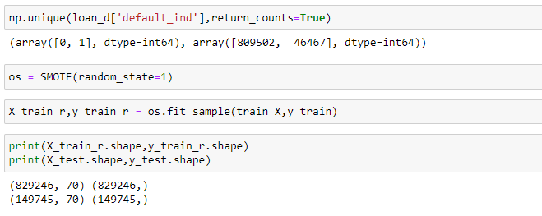
Datasets Preparation for Model Building
Over or Under Sampling the Minority Variables - SMOTE
Synthetic Minority Oversampling Technique - works by selecting examples that are close in the feature space, drawing a line between the examples in the feature space and drawing a new sample at a point along that line. Specifically, a random example from the minority class is first chosen. Then k of the nearest neighbour's for that example are found (typically k=5). A randomly selected neighbour is chosen and a synthetic example is created at a randomly selected point between the two examples in feature space.
https://machinelearningmastery.com/smote-oversampling-for-imbalanced-classification/

Slide 19
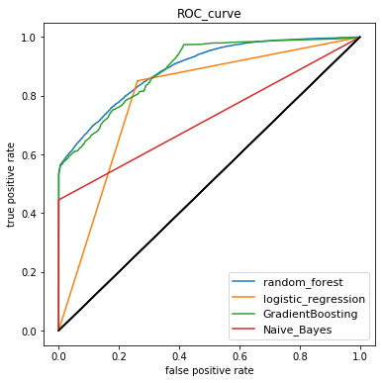
Model Building
Running classifier techniques on Train Dataset
Classifier Methods Logistic Regression Gradient Boosting Random Forest Naïve Bayes GridSearchCV Parameters – Basic parameters | Metrics/Scores - Recall Precision ROC_AUC F1_score CV Best Score
Model | Best score | Roc_Auc score | Precision score | Recall score | F1 score
Logistic Regression | 0.990 | 0.795 | 0.214 | 0.850 | 0.342
Gradient Boosting | 0.994 | 0.892 | 0.986 | 0.537 | 0.696
Random Forest | 0.989 | 0.893 | 1.000 | 0.505 | 0.671
Naïve Bayes | 0.919 | 0.723 | 1.000 | 0.445 | 0.616

Slide 20

Final_Model Building
Logistic Regression – Performance Better than other methods
Banking industry is more concerned about Loan defaulters rather than non-defaulters , for predicting defaulter "Recall" is better metrics than other metrics used. After trying different classifier, identify that "Logistic Regression" has better "Recall_Score" than other classifier's. Will choose “Logistic Regression” for final model validation with Test Data by running GridSearchCV, hypertuning parameters.
Hyper Tune Parameters
#Param_grid for Logistic Regression model 1. penalty = ['l2'] 2. c_values = [100, 10, 1.0, 0.1, 0.01] 3. scoring = ['accuracy','recall','precision','f1']

Slide 21
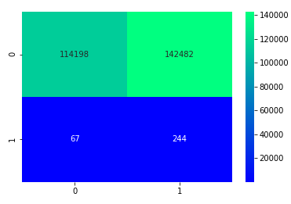
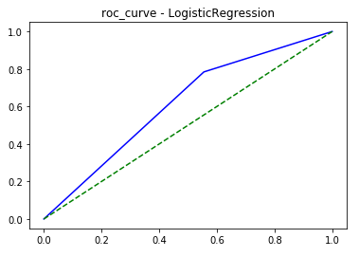
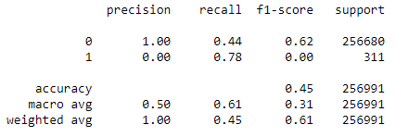
Final Model Building Contd.,
Confusion Matrix
ROC Curve
Classification Report

Slide 22
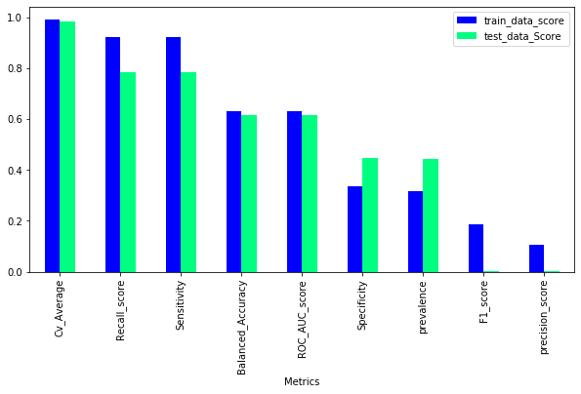
Performance Metrics - Comparison
Model | Train_Data Score | Test_Data Score | Score Diff
Cv_Average | 0.992 | 0.984 | -0.008
Recall_score | 0.924 | 0.785 | -0.139
Sensitivity | 0.924 | 0.785 | -0.139
Balanced_ Accuracy | 0.630 | 0.615 | -0.016
ROC_AUC_ score | 0.630 | 0.615 | -0.016
Specificity | 0.337 | 0.445 | 0.108
prevalence | 0.317 | 0.445 | 0.127
F1_score | 0.187 | 0.003 | -0.184
Precision_score | 0.104 | 0.002 | -0.103
Train_Data refers = Train dataset
Test_Data refers = Test dataset

Slide 23
Recommendation based on prediction

Slide 24
Model Solutions
Basic Impact Loan Default on Banking
At large, the main effect of bad loans is the fact that increasing bad loans limit the financial growth of corporation. This consequence is as a result of the fact that bad loans deprive corporation of the needed liquidity and limit their capability to fund other potentially viable businesses and make credit facilities available to individuals.
Benefits based on Model Result
Better Productivity Better Decision Making Smarter Fraud Detection Consistency in Underwriting Scalability

Slide 25
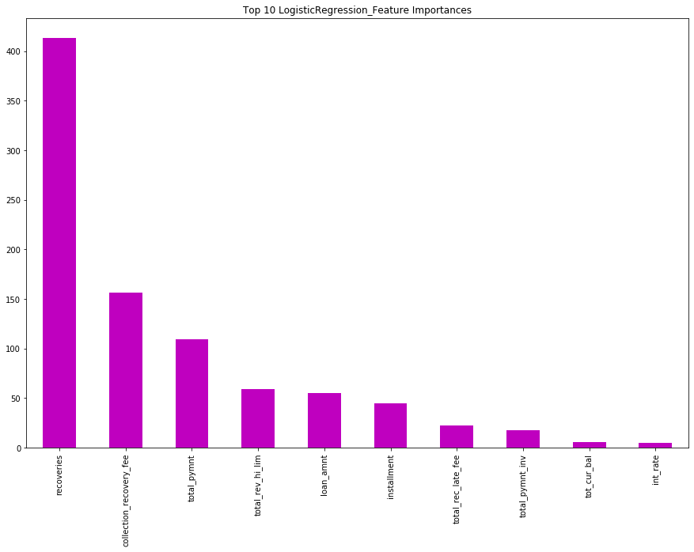
Important Features – Top 10

Slide 26
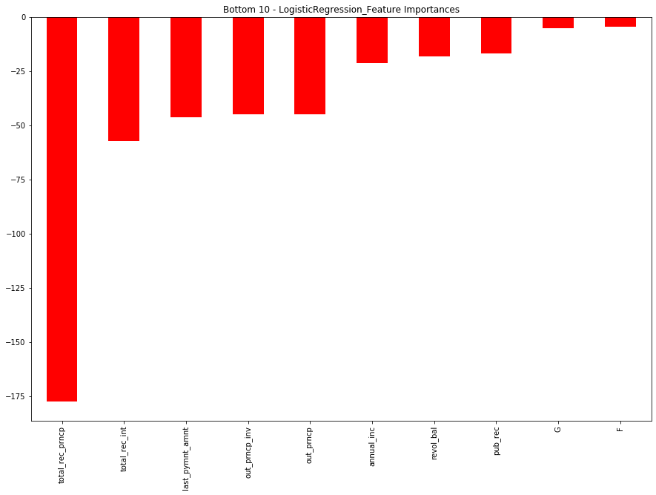
Important Features – Bottom 10

Slide 27
Appendix

Slide 28
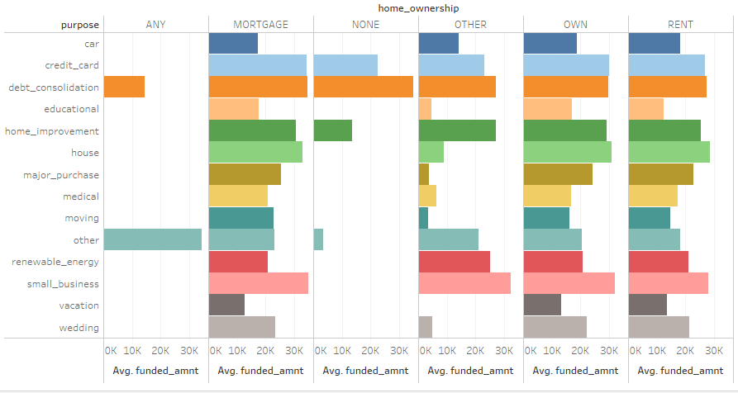
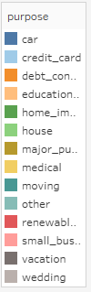
Comparison - Purpose Vs Home_ownership with Average Fund Amount

Slide 29
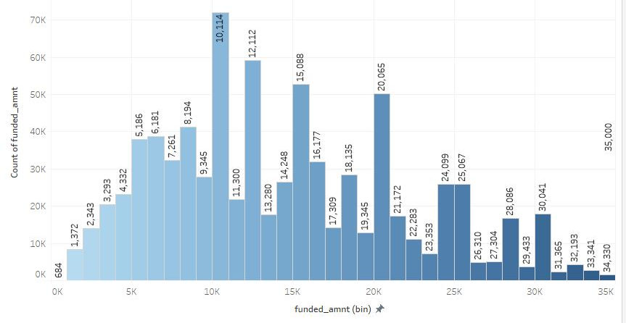

Distribution of Funded_Amount (Average)

Slide 30
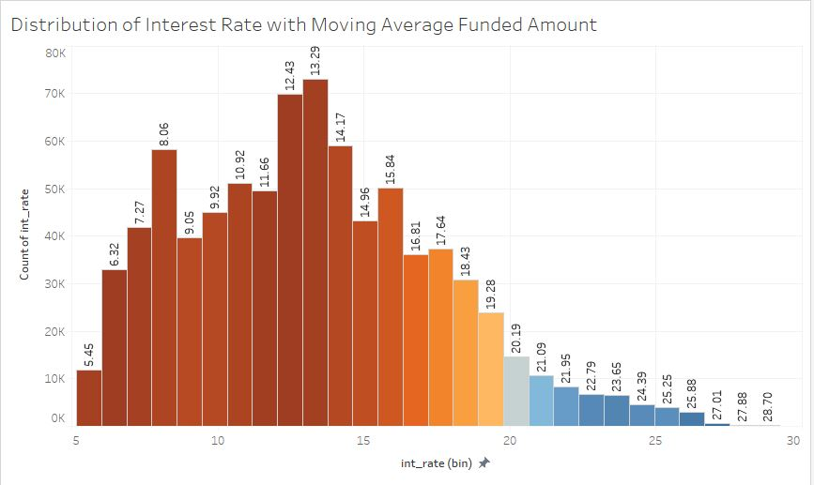

Distribution of Interest Rate (Hue by Funded_Amount Moving Average)

Slide 31
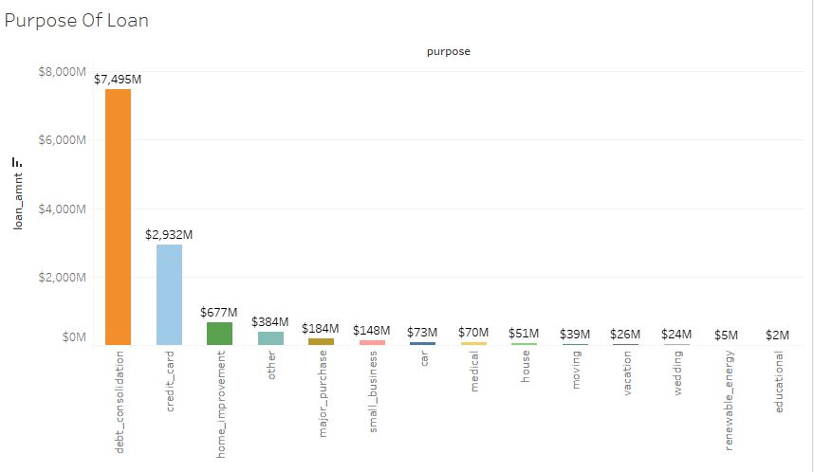
Distribution of Purpose Loan

Slide 32
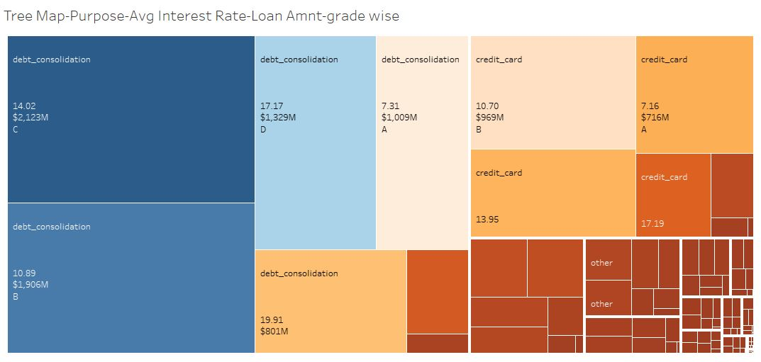
Tree Map - Purpose vs Average - Interest Rate (Hue by Loan Amount)

Slide 33
Dataset's
# | Column | Dtype
1 | issue_d | datetime64[ns]
2 | loan_amnt | float64
3 | funded_amnt | float64
4 | funded_amnt_inv | float64
5 | int_rate | float64
6 | installment | float64
7 | annual_inc | float64
8 | dti | float64
9 | delinq_2yrs | float64
10 | inq_last_6mths | float64
11 | mths_since_last_delinq | float64
12 | mths_since_last_record | float64
13 | open_acc | float64
14 | pub_rec | float64
15 | revol_bal | float64
# | Column | Dtype
16 | revol_util | float64
17 | total_acc | float64
18 | out_prncp | float64
19 | out_prncp_inv | float64
20 | total_pymnt | float64
21 | total_pymnt_inv | float64
22 | total_rec_prncp | float64
23 | total_rec_int | float64
24 | total_rec_late_fee | float64
25 | recoveries | float64
26 | collection_recovery_fee | float64
27 | last_pymnt_amnt | float64
28 | collections_12_mths_ex_med | float64
29 | mths_since_last_major_derog | float64
30 | policy_code | float64

Slide 34
Dataset's
# | Column | Dtype
31 | annual_inc_joint | float64
32 | dti_joint | float64
33 | acc_now_delinq | float64
34 | tot_coll_amt | float64
35 | tot_cur_bal | float64
36 | open_acc_6m | float64
37 | open_il_6m | float64
38 | open_il_12m | float64
39 | open_il_24m | float64
40 | mths_since_rcnt_il | float64
41 | total_bal_il | float64
42 | il_util | float64
43 | open_rv_12m | float64
44 | open_rv_24m | float64
45 | max_bal_bc | float64
# | Column | Dtype
46 | all_util | float64
47 | total_rev_hi_lim | float64
48 | inq_fi | float64
49 | total_cu_tl | float64
50 | inq_last_12m | float64
51 | id | int64
52 | member_id | int64
53 | default_ind | int64
54 | term | object
55 | grade | object
56 | sub_grade | object
57 | emp_title | object
58 | emp_length | object
59 | home_ownership | object
60 | verification_status | object

Slide 35
Dataset's
# | Column | Dtype
61 | pymnt_plan | object
62 | desc | object
63 | purpose | object
64 | title | object
65 | zip_code | object
66 | addr_state | object
67 | earliest_cr_line | object
68 | initial_list_status | object
69 | last_pymnt_d | object
70 | next_pymnt_d | object
71 | last_credit_pull_d | object
72 | application_type | object
73 | verification_status_joint | object

Slide 36



